Slide 1
Thesis Meeting
27/05/2022

Slide 2
What am I doing
Proposing a new algorithm based on Schwartz-Hearst that will be able to extract Acronym-Expansion pairs that are defined without specific characters such as parentheses
Adapting the AcX system to support Cyrilic languages (Bulgarian)
Building an annotated dataset for Bulgarian Wikipedia articles

Slide 3
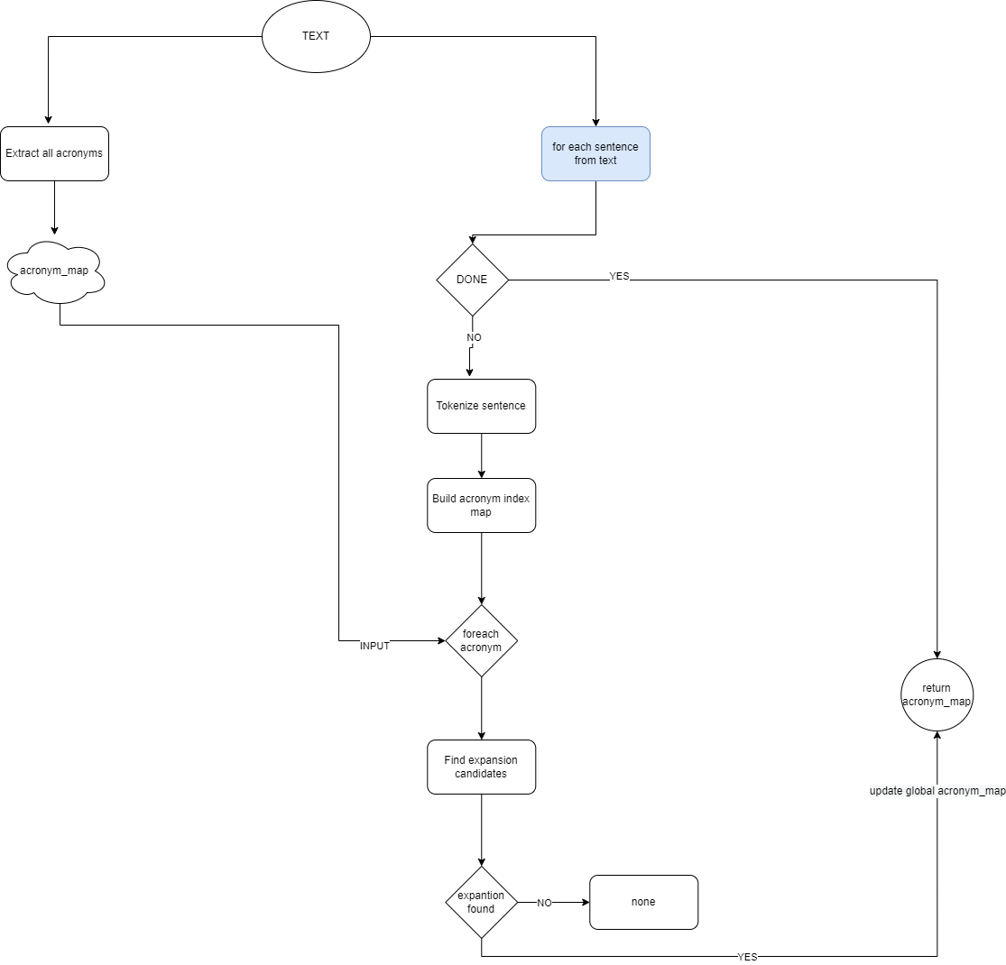

Slide 4
Pseudo code algorithm:
Extract all acronyms from the text For each sentence: tokenize the sentence build acronym index map, if acronym is present in the sentence get it index and map it to the acronym check for complex acronyms and merge them, if acronym contains empty spaces is considered for a complex acronym For each acronym from acronym index map: Retrieve acronym capital letters Retrieve first and last capital letter (representing the first letters of the first and last words from the expansion) Check if the expansion can be before and after the acronym find the last word index find the first word index extract the possible candidates and send it for a check check if all the words of the expansion check match the capital letters from the expansion if yes return expansion if no return None Check if the expansion can be before find the last word index extract the possible candidate and send it for a check check if all the words of the expansion check match the capital letters from the expansion if yes return expansion if no return None
Check if the expansion can be after find the first word index extract the possible candidate and send it for a check check if all the words of the expansion check match the capital letters from the expansion if yes return expansion if no return None If non of the cases is present, then go to next acronym

